Slide 1




To all of you

Slide 2

About myself

Slide 3
Take away
At the end of this session you will learn to avoid some common mistakes done while working with Microsoft SQL Server. This will help SQL Server work more efficiently for you and your organization.

Slide 4
Let’s avoid common mistakes in SQL Server

Slide 5
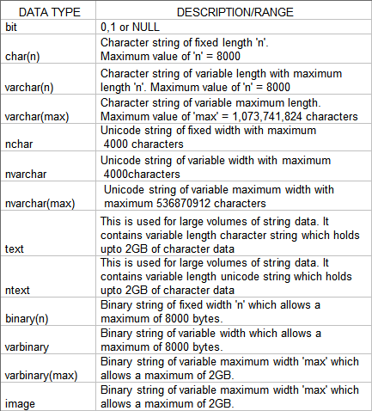
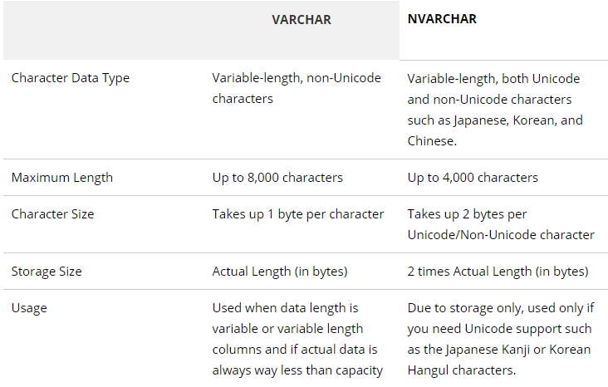
What are these common mistakes?

Slide 6
What are these common mistakes?
Data Types
Choose the data type wisely
It can make your estimation go wrong
Using CHAR instead of VARCHAR
It can make your execution plan costly
For example, comparing two different type of data type
Reading Joy:
https://docs.microsoft.com/en-us/sql/t-sql/data-types/data-types-transact-sql?view=sql-server-2017

Slide 7
DEMO - 1

Slide 8
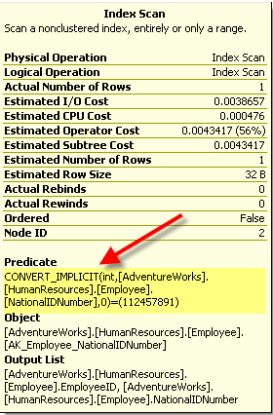
What are these common mistakes?

Slide 9
What are these common mistakes?
Implicit Conversion
Convert_Implicit
What is Convert_Implicit
What impact it will make
Try to avoid point 1 as much as you can
Want to know how?
Reading Joy:
https://docs.microsoft.com/en-us/sql/t-sql/data-types/data-type-conversion-database-engine?view=sql-server-2017#data-type-conversion-behaviors

Slide 10
DEMO - 2

Slide 11

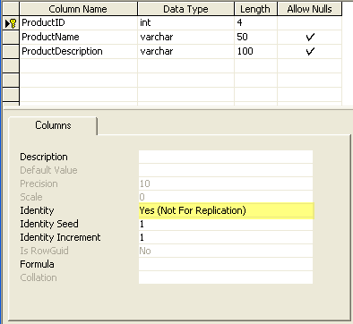
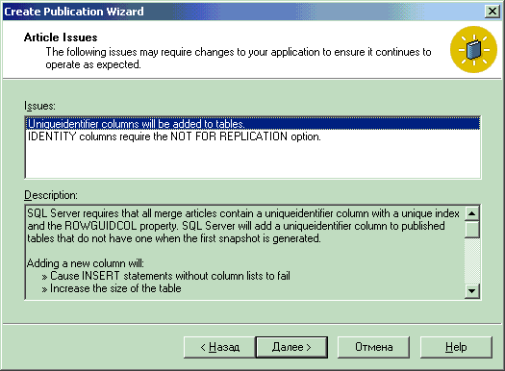
What are these common mistakes?

Slide 12
What are these common mistakes?
Identity property for Primary Key
Using Identity values as a Primary Key
It causes Identity Crisis
You cannot control the values
You cannot add Identity property to an existing column. Only two options
Drop and Add a column
Add a new column
Replicated Database
Don’t forget to set “Not For Replication”
Reading Joy:
https://www.sqlteam.com/articles/identity-and-primary-keys
https://www.sqlteam.com/articles/custom-auto-generated-sequences-with-sql-server

Slide 13
DEMO - 3

Slide 14

What are these common mistakes?

Slide 15
What are these common mistakes?
Do you have NULL values?
In case you have NULL values and you can’t avoid having them it’s okay
But let’s see why you shouldn’t have a NULL values
Let’s see an example

Slide 16
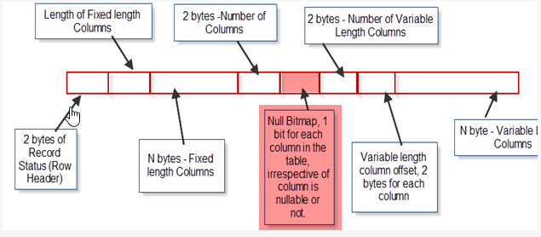
What are these common mistakes?

Slide 17
What are these common mistakes?
Introduction to a NULL_BitMap
Null Bitmap is mask value. It is used to say if the column has null value or not. When a column has NULL value it set a bit 1 and when a column doesn’t have a NULL value it sets a bit 0.
NULL values occupy the space when a data type is of fixed value
Reading Joy:
https://sqluninterrupted.com/2012/10/16/sql-server-record-structurespart-1/

Slide 18
DEMO - 4

Slide 19

What are these common mistakes?

Slide 20
What are these common mistakes?
Auto Growth property
Auto Growth on or off?
Auto Growth in percentage or Fixed MB

Slide 21
DEMO - 5

Slide 22

What are these common mistakes?

Slide 23
What are these common mistakes?
SQL Server IO – When you fire a statement like SELECT, INSERT, UPDATE or DELETE from the client side it goes to SQL Server and come back with an answer/result. It will use some disk IO.
For example, you want to get Order and Sub-Order details from the same table, you should write the single select statement instead two select statement.

Slide 24
DEMO - 6

Slide 25
Summary
Choose the proper and correct size data types, when you can’t decide go for variable length data type
If you have to compare values, or use join make sure you are using exact same data type to avoid Implicit conversion
Avoid using the Identity columns for Primary Key as much as you can
Consider NULL values and the size it occupy at the time of designing your application and database
Make sure you choose right size of data base file and auto growth value
Try to reduce the IO/CPU in order to get efficient work from application

Slide 26


Slide 27
Feedback
Be a part of the Surat SQLPASS Chapter to get notified of new events
https://suratusergroup.pass.org/default.aspx
Please provide feedback
http://bit.ly/SQLSurat

Slide 28
Thank you
આભાર

